Slide 1
What you will learn Today
Introduction
Test data generation and test environment setup to successfully be able to execute your test cases
Test Execution, Bug Reporting and Bug Tracking.

Slide 2
Table of Content
Introduction
Revisit Test Cases and Risk Assessment from Previous exercise
What is test data and what is its importance?
Test Data Generation
Test Environments
Test Execution and Tracking
Bugs and Bug Reporting
Bugs’ life cycle

Slide 3
Revisit Test Cases and Risk Assessment from previous day

Slide 4
Test Data and Its Importance

Slide 5
Test Data
Test Data
Data that is used in testing
Test data is used to verify that the application works as-expected given the decided set of input data
Test data is also used to satisfy test preconditions and postconditions
Test data may consist of synthetic (fake) or representative (real) values for any given input field

Slide 6
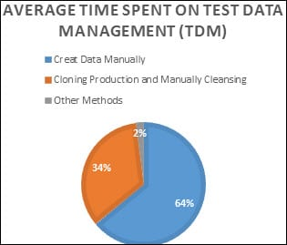
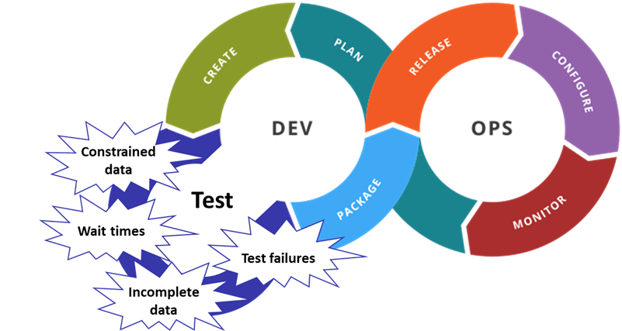
Importance of Test Data
Test Data
Preparation & maintenance of test data consumes between 30%-60% of the tester’s time
Manual Test data practices create bottlenecks in CI/CD pipelines

Slide 7
Test data is ideal if it identifies all application errors with minimum size of data set
Test Data

Slide 8
Example
Test Data
You are designing test cases for Whatsapp. You want to test if the Whatsapp shows correct messaging history for all types of user. Identify what test data you would need?
A new user with no messaging history/call history
A very old user with lots of messaging history. Messages including
Images
Text
Voice
An old user that switched mobiles between android / IOS
Old user who deleted their account and then recreated it

Slide 9
How to Create Test Data
Test Data Management
Manual test data generation
Time consuming and bottleneck for testing in CI/CD
Only recommended in Exploratory testing
From production data
Sensitive Data should be Masked
Synthetic Data should be added where required
Data subletting/sampling should be done to build compact but complete test data
Using Test Generation Tools
Quick data generation using online tools
Manually
Using Test Generation Tools
From Production

Slide 10
Challenges in Preparing Test Data
Test Data Management
Testing team lacking knowledge and skills in test data generation tools
Delay in production data access to the testers
Production data not being fully usable in case of developing business scenarios
Large volumes of data required
Synthetic data is less reliable and credible
Non-representative data fails to identify critical bugs
Replication and/or sharing of sensitive data can create legal issues
Protecting Test Data to standard compliances

Slide 11
Test Data Creation Criteria
Test Data Management
Following categories of test data should be considered while designing test data:
No data: Check system response when no data is submitted
Valid data: Check system response when Valid test data is submitted
Invalid data: Check system response when InValid test data is submitted
Boundary Condition Dataset: Test data meeting boundary value conditions
Equivalence Partition Data Set: Test data qualifying your equivalence partitions.

Slide 12
Test Data Management Strategies
Test Data Management
01
Flat files based on Mapping rules
Simple text files / CSV files
Can be generated manually, exported from production if available, Generated using tools
02
SQL scripts to extract Data from existing systems
Maintaining SQL Queries to extract Data when required
03
Production Data
Manage sanitized production data to be used when required
04
Test Data Automation Tools
Tools that can find and make required data
Can be commercial/open-source tools or custom made module to populate required test data

Slide 13
Making Test Data always Available
Test Data Maintenance
Keeping Data up-to-date
Need to update test data after any change in data model.
Updates will be according to the test data management strategy
Guarding Data from Corruption
Maintain backup of test data
Return modified data to its original state after test execution
Data division among the testers
Informing the team on any changes to test data

Slide 14
Test Environments

Slide 15
A testing environment is a setup of software and hardware on which the testing team is going to execute test cases. The test environment consists of real business and user environment, as well as physical environments, such as server, front end running environment.
Test Environment

Slide 16
Different Major Available Environments
Test Environment
01
Development Environments
Used by dev teams for feature preview and Collaboration
No Client Data
02
QA/Test Environments
Used by QA and project team for acceptance testing with test data
No client Data
Company may have multiple QA/Test Environments
03
Staging Environment
Pre-production environment used for final acceptance based on production sized data set
Limited production data
Scaled down replica of Production environment
04
Production Environment
Used by clients (live)
Full Production Data

Slide 17
Setting Up Test Environments
Test Environment
Test Environments should be ready and available before the test execution
Environment should be fit for purpose
Operate normally when failures are not occurring so that we can focus on real software bugs
Different test environment setups might be required for different testing technology stacks.

Slide 18
Setting Up Test Environments
Test Environment
Key setup components
System and applications components (Frontend, backend, data server, etc)
Test Data
Operating system
Browsers
Hardware includes Server operating system
Network

Slide 19
Test Environments Management
Test Environment
Test Environment management as per the test team demands
Creating new environments as per the new requirements
Updating/Deleting outdated test environments
Investigation of issues on the environment
Coordination till an issue resolution

Slide 20
Test Execution

Slide 21
The activity that runs a test on a component or system producing actual results.
Test Execution

Slide 22
Test Execution Entry Criteria
Test Execution
Test Bed (Test Environment + Test Data) is available
Tester has access to all required systems, applications, application logs, third-party software integrated with application, and any other tools

Slide 23
Test Execution Basic Tasks
Test Execution
Executing manual tests, including exploratory testing
Executing automated tests
Comparing actual results with expected results
Reporting defects based on the failures observed
Executing regression tests

Slide 24
Test Execution Prioritization
Test Execution
Execute Acceptance tests considering
Current Changes under test (User Stories Acceptance Criteria)
Regression test, Integration testing & System testing

Slide 25
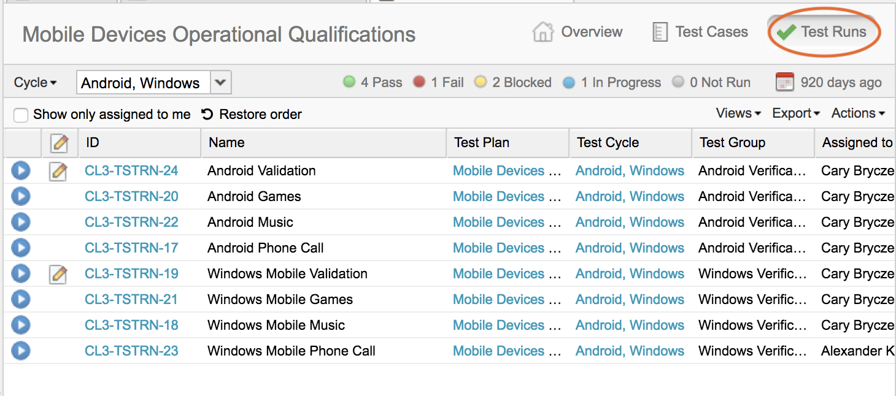
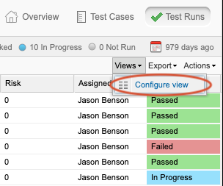
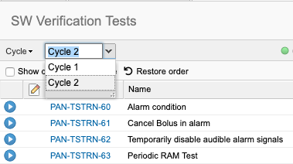
Test Execution Tracking
Test Execution
Test Management Tools are user to create test cycles according to test plans.
During execution, Tester needs to update the test case execution status properly
In-Progress
Passed
Failed
Blocked

Slide 26
Bug Reporting

Slide 27
One major task during test execution is reporting defects based on the failures observed
Bug Reporting

Slide 28
Bug Report
Bug Reporting
Test Management Tools are user to create test cycles according to test plans.
Bug Report Components
Identifier
Title/ Summary
Reporting Date
Reporter
Test Item
Test Environment
Description
Steps to reproduce
Test Data used
Screenshots / screencasts
System Logs and any attachment that can help
Expected & Actual Results
Severity
Priority
Status

Slide 29
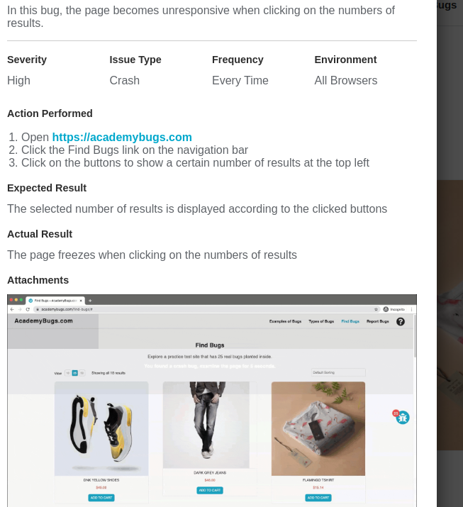
Bug Report
Bug Reporting

Slide 30
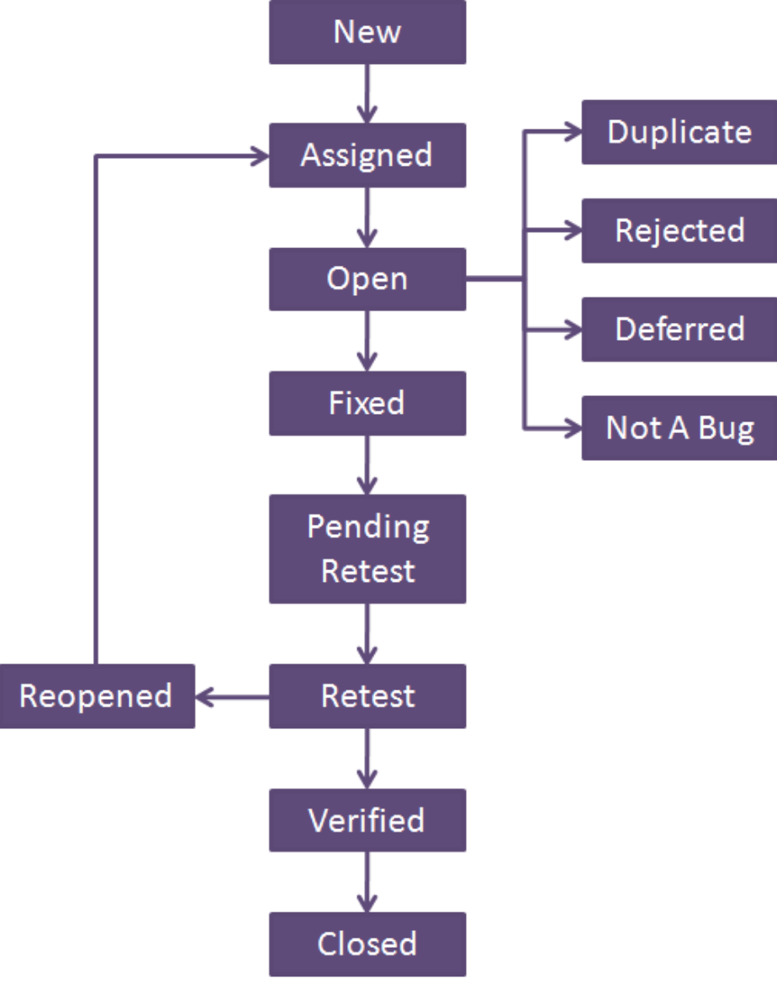
Bug’s Lifecycle
Bug Reporting
This is a typical bug life cycle
In Agile, Bug is reported along side stories and therefore have similar workflows as regular story/task
Notice, not all bugs are fixed
There's not enough time
It's really not a bug
It's too risky to fix
It's just not worth it
Ineffective bug reporting

Slide 31
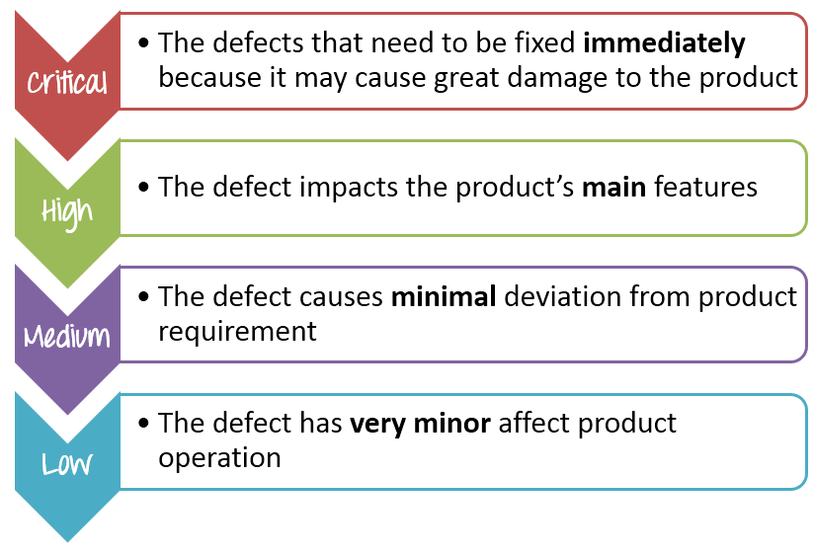
Bug Reporting
Bug’s Severity Levels

Slide 32
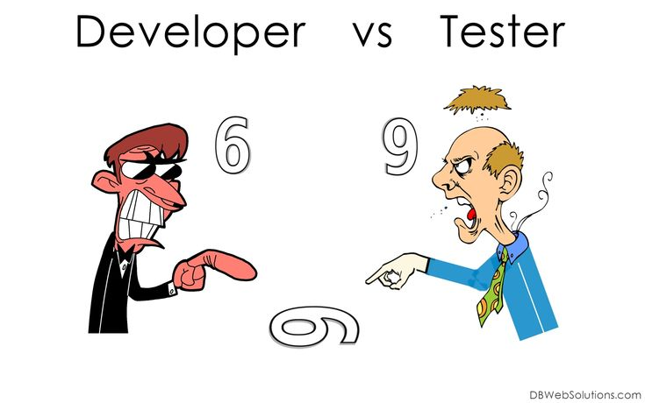
Challenges of Bug Reporting
Bug Reporting
Difficult to analyze and report bugs that are have random occurrences
Lack of process for bug logging
Improper defect triage/communication process
Improper setup of Severity and Priority
Communication Gaps between Testers and Developers

Slide 33
Bug Reasons
Bug Reasons
Incorrect Functionality: Problem occurred because functionality which was identified at the time of design was not implemented due to some reasons.
Not Reproducible: Bug reported in QA environment is not reproduced either in development environment or it’s automatically fixed somehow in QA environment later.
Regression: Problem already exist in the code/Feature and not occurred due to the recent change but fixed by dev with the recent change scope.
Duplicate Bug: Bug already reported by same or different QA resource.
Tool Limitation: Bug cannot be fixed due to technology/tools limitation being used

Slide 34
Exercise
Bug Reporting
Define Severity of following
The website performance is too slow
The login function of the website does not work properly
The GUI of the website does not display correctly on mobile devices
The website could not remember the user login session
Some links doesn’t work

Slide 35
Reading Break and Exercise

Slide 36
Let’s find some Bug and view the Report
Bug Reporting
https://academybugs.com/find-bugs/

Slide 37
Exercise
Functional Testing
Find bugs on https://academybugs.com/find-bugs/
Play the game at https://cantunsee.space/

Slide 38
Reading
What is Software Testing
https://www.softwaretestinghelp.com/tips-to-design-test-data-before-executing-your-test-cases/
https://medium.com/@faixan78620/create-the-perfect-test-data-for-hr-software-f2acced9e717
https://curiositysoftware.medium.com/5-test-data-challenges-that-every-cto-should-know-about-ac0180246d49
https://istqb-main-web-prod.s3.amazonaws.com/media/documents/ISTQB_CTAL-TA_Syllabus_v3.1.2.pdf
1.5

Slide 39
Reading
What is Software Testing
https://istqb-main-web-prod.s3.amazonaws.com/media/documents/ISTQB-CTFL_Syllabus_2018_v3.1.1.pdf
`1.4.2` subsection `Test Execution`
https://istqb-main-web-prod.s3.amazonaws.com/media/documents/ISTQB_CTAL-TA_Syllabus_v3.1.2.pdf
1.6
https://www.tutorialspoint.com/stlc/stlc_test_execution.htm
http://www.softwaretestingstuff.com/2010/10/common-problems-in-bug-tracking.html

Slide 40
Q&A
Instructor Notes

